Slide 1
Employee Data Analysis using Excel
STUDENT NAME : MIRA DARSHINI S
REGISTER NO : 322200017
NMID : A28D1D32B9E3F7AA53643CA9BBD9C3D3 DEPARTMENT : BCOM(HONS)
COLLEGE : ANNA ADARSH COLLEGE FOR WOMEN

Slide 2
PROJECT TITLE
Analysis of employee’s performance using Excel

Slide 3


AGENDA
Problem Statement
Project Overview
End Users
Our Solution and Proposition
Dataset Description
Modelling Approach
Results and Discussion
Conclusion
3/21/2024 Annual Review

Slide 4

PROBLEM STATEMENT
By increasing the quality of work, the employees try to enhance the organisations reputation and customer satisfaction.
Better performance motivates the employees to work hard to get bonus, promotion, increments etc.
Monitoring and managing the performance of the employee helps in their growth and development.

Slide 5

PROJECT OVERVIEW
Employee performance analysis involves the systematic examination of individual and team performance within an organisation. By evaluating various metrics and key performance indicators (KPIs), organisations can gain insights into how effectively employees are fulfilling their roles, contributing to business objectives, and where improvements can be made.
Analysing the performance of the employee by considering various factors like gender, ratings, performance scores, achievements etc is done to identify the trends of different categories of employees like high, medium and low.

Slide 6
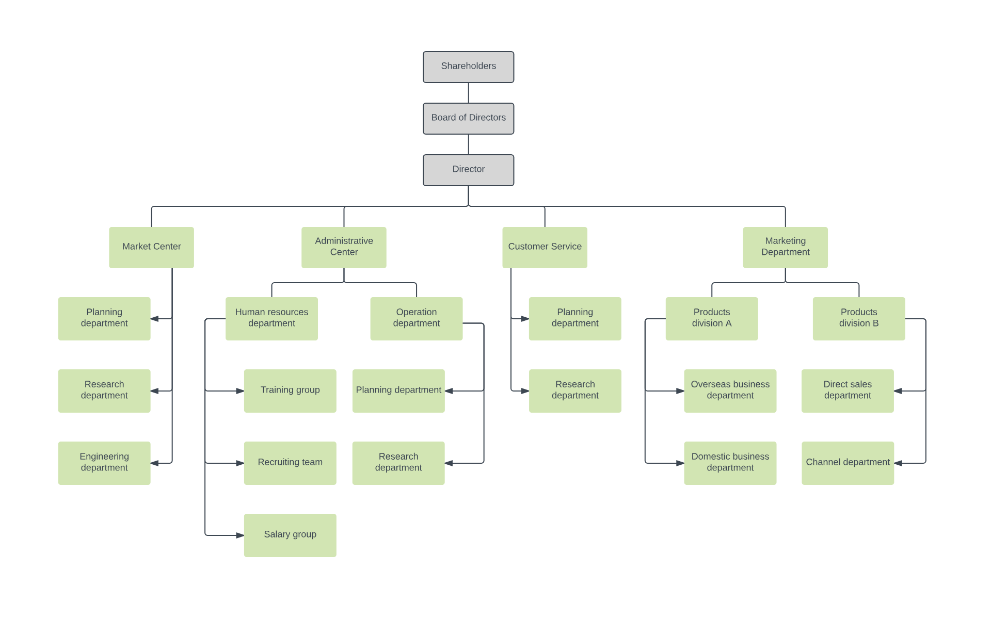

WHO ARE THE END USERS?
Employees
Organisations
Managers
Employers
Board of directors
Directors

Slide 7

OUR SOLUTION AND ITS VALUE PROPOSITION
Filtering to remove the missing values
Using pivot table to create a summary about the performance of the employee.
Using conditional formatting
Applying the formula of IFS to analyse the performance.
The graphs shows the final report and for data visualisation.

Slide 8
Dataset Description
Employee data set collected from- Kaggle, including total 26 features, where 9 features were considered.
The features included: employee ID(numerical), name(text), employee type(text), performance level, gender(male, female), employee rating(numerical), business unit(text), department type(text) and performance score.

Slide 9

THE "WOW" IN OUR SOLUTION
1. Computation of performance level using formula:
=IFS(Z8>=5,"Very High”,Z8>=4,"High",Z8>=3,"Medium",TRUE,"Low")
2. Data visualisation through graphs.
3. Summary of the employees performance represented through pivot table.
3/21/2024 Annual Review

Slide 10
MODELLING
Data collection through Kaggle.
Feature selection/collection: employee-id, business unit, gender, performance score and employee type.
DATA CLEANING:
Computation of performance level using formula:
=IFS(Z8>=5,"Very High”,Z8>=4,"High",Z8>=3,"Medium",TRUE,"Low")
4. The summary of the performance is represented through Pivot Table.( business unit rows and gender filter)
5. Slicer is used for employee type

Slide 11
RESULTS
GenderCode | (All)
DepartmentType | (All)
Count of FirstName | Performance level
BusinessUnit | High | Low | Medium | Very High | Grand Total
BPC | 16 | 34 | 85 | 15 | 150
CCDR | 18 | 47 | 65 | 15 | 145
EW | 21 | 41 | 78 | 14 | 154
MSC | 17 | 39 | 92 | 9 | 157
NEL | 21 | 41 | 77 | 15 | 154
PL | 29 | 33 | 69 | 12 | 143
PYZ | 26 | 41 | 75 | 15 | 157
SVG | 26 | 43 | 82 | 16 | 167
TNS | 21 | 45 | 71 | 13 | 150
WBL | 25 | 34 | 84 | 13 | 156
Grand Total | 220 | 398 | 778 | 137 | 1533

Slide 12
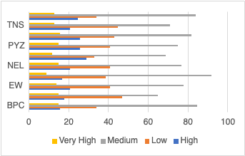
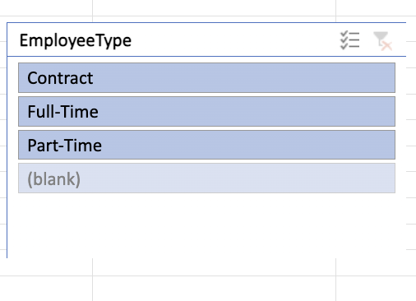
RESULTS

Slide 13
conclusion
It is concluded that the higher the performance score leads to higher performance level and leading to employee satisfaction by motivating by fulfilling the organisation as well as the employees interests.
Ultimately, effective performance analysis contributes to the long-term success and competitiveness of the organization, ensuring that every stakeholder has the insights needed to make informed, impactful decisions.

